Slide 1
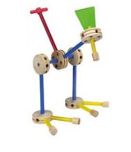
One year review of the Emerging Technology Grant for Digital Systems Education
Jim Brakefield jim.brakefield@ieee.org
IEEE Computer Society
Notes:
Tinker toy (or LEGO block) construction embodies the generation/design of abstract objects from simple uniform components

Slide 2
Preliminaries
Funding provided by a grant from the IEEE Computer Society as part of their Emerging Technologies program
St. Mary’s University provided classrooms
I’m Jim Brakefield, jim.brakefield@ieee.org
Full set of files at: https://github.com/jimbrake/20-dollar-FPGA-kit
Introduction to FPGA video: https://www.youtube.com/watch?v=EVy4KEj9kZg

Slide 3
Caveats
This is a search for lowest cost parts
Availability and pricing may vary
Ordering from AliExpress typically takes a month for delivery
In the last few years FPGA boards have dramatically increased in price + chip shortages
At the university level and for best experience there are boards for $80 (academic pricing)

Slide 4
Outline
Some FPGA basics
The FPGA Boot Camp review
Choice of boards
Terasic DE-10 Lite
RealDigital Boolean board
Comments
The $20 FPGA kit choices
The Seeed Studio Tang nano 9K
The Alinx AX309 Spartan-6 board
Advanced FPGA subjects of note
RealDigital board selection
AMD/Xilinx academic boards
Intel/Altera academic boards

Slide 5
FPGA Basics
LUTs Four to six inputs, one or two outputs
Consistent within a family of parts
A 6LUT equals approximately 1.5 4LUTs
D flip-flops Clock & D in, Q & not-Q out
Block RAM Two R/W ports, aspect ratio adj.
IO pins Voltage & drive strength adj.
DSP Multiply and/or accumulate
Tools Open source or vendor provided
Free tools for small & medium size low cost parts
Notes:
IO pins, via constraint files, support dozens of IO standards. DSP multipliers vary from 16 by 16 to 18 by 25 with varying capabilities for cascading. Usually one DFF per 4LUT and two DFF per 6LUT.

Slide 6
LUTs
Performing Boolean Algebra inside an FPGA using Look-Up Tables (LUTs)
https://nandland.com/lesson-4-what-is-a-look-up-table-lut/:
“Note to the reader: many textbooks and classrooms will spend a
significant amount of time discussing how LUTs can be wired to
create the optimal solution to a Boolean expression. Optimal
means that it uses the least number of gates possible. Topics
such as De Morgan’s Law, Karnaugh Maps, the Quine-McCluskey
method, and others are usually discussed at great length that
describe how to optimize digital logic. However I feel that this is
not necessary to begin learning about FPGAs.”
Notes:
The four main user visible components of an FPGA: LUTs, block RAM, D flip-flops and IO pins. DSP units include a multiplier and an accumulator. All connected by programmable wiring.

Slide 7
Block RAM tutorial
https://nandland.com/lesson-15-what-is-a-block-ram-bram/
Notes:
The four main user visible components of an FPGA: LUTs, block RAM, D flip-flops and IO pins. The others include clock generators and the DSP/multiply/accumulator.

Slide 8
The FPGA Boot Camp task
Establish a minimum set of features
Find lowest cost boards
Establish a Boot Camp program/slide deck
Modify the Digital Designer tool
Conduct the classes
Comments
Modest price increases
Vivado disk space
Local university courses
Notes:
Trinity and St. Marys use Terasic DE-10. UTSA uses BASYS-3 ARTIX-7. Boards signed out to the student for the semester.
Terasic DE-10 Lite went from $77 to $82 (academic prices). Realdigital Boolean board went from $69 to $74 (academic prices).

Slide 9
The FPGA Boot Camp Board choices
Realdigital Boolean board
Located in USA
15 week courseware
(16) switches & LEDs, (8) 7-segment digits
Constraint files generated by Digital Designer
Terasic DE-10 Lite
Located in Taiwan
Some course material https://fpgacademy.org/courses.html
(10) switches & LEDs, (6) 7-segment digits
Academic pricing harder to obtain
Notes:
Shipping from Realdigital.org was from three to five days. Boot Camp files at https://github.com/jimbrake/FPGA_Boot_Camp have a date code suffix and are updated occasionally.

Slide 10
DE10-Lite versus Boolean board
DE10-Lite Boolean board
50K 4LUT MAX-X = 33K 6LUT Spartan-7
1.7Mb block RAM = 2.8Mb block RAM
64MB DRAM + No DRAM
SD card slot + No SD card slot
VGA = HDMI
Quartus 15GB + Vivado 33GB (no Vitis)
Schematic capture = Use Digital Designer
Use constraint editor ++ Generated constraint file
$82 + $74
Ready to use = Ready to use
Mainstream tools (Quartus) = Mainstream tools (Vivado)
Usable without wiring = Usable without wiring
Slide switches = Slide switches
Notes:
A major factor was the availability of a 15 week courseware for Boolean board at RealDigital.org. Currently several universities issue an FPGA board to each student for a one semester course.

Slide 11
The FPGA Boot Camp agenda With plenty of hands-on time
Two Saturdays with lunch from Jason’s, 9AM-4PM
First Saturday:
Introductory FPGA video (20 minutes)
Install Digital Designer
Configure for Boolean Board
Students draw schematic(s) & exercise schematic
Second Saturday:
Examine generated VHDL/Verilog & constraint file
Install Vivado
Show Vivado project creation & flow
The students install circuit created on previous Saturday

Slide 12
The FPGA Boot Camp Comments
Students
from 9th grade to grad students & continuing ed.
High school: mostly from STEM & charter school
Vivado needed 80GB of disk space!
Horrors, later trimmed to 33GB
Students given their boards on 2nd Saturday
High number of no-shows
Intel/Altera tool (Quartus) supports schematic capture with manual entry of constraints

Slide 13
The $20 FPGA Kit agenda documentation at: https://github.com/jimbrake/20-dollar-FPGA-kit
To make the FPGA experience available to all
Very few FPGA boards for under $20
The Tang 9K Nano kit $18 in quantity
DRAM, SD card slot, HDMI & LCD connectors
Use add-on 7-sgement display with buttons, LEDs
The Alinx Spartan-6 kit $21 with shared JTAG bd.
DRAM, SD card slot, VGA connector
Has 7-segment display, buttons & LEDs
Both have ~9K LUTs, Block RAM & DSP units
Unable to find an comparable Intel/Altera board
Notes:
The LUT count, DRAM and SD card slot means that the board can be used for soft core processors such as 6502, Z80, AVR etc. The SD card can be used as a disk file device supporting an operating system. https://www.cnx-software.com/2022/01/17/tang-nano-9k-fpga-board-can-emulate-picorv32-risc-v-soft-core-with-all-peripherals/

Slide 14
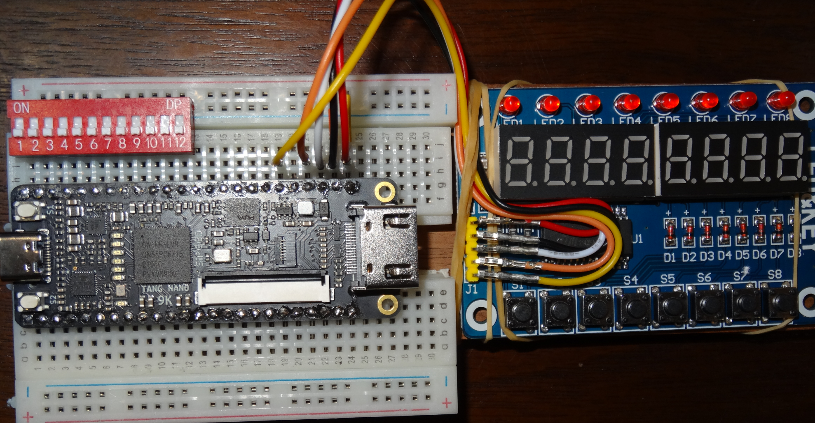
Tang Nano 9K kit assembled
The kit using the Tang 9K Nano for high volume has a per kit price of $17.89
In low volume (for a single kit) is $25.93 plus shipping and taxes with some
spare parts left over (extra breadboards and jumper wires).
Notes:
Pricing for thirty kits for a classroom about $20 each plus shipping and taxes. Spreadsheet has several sources for each of the items. One could use two five position DIP switches? Be sure to get jumpers with insulated ends. For a long breadboard picture see Long Breadboard slide. The longer breadboards have power rows aligned with pin columns.

Slide 15
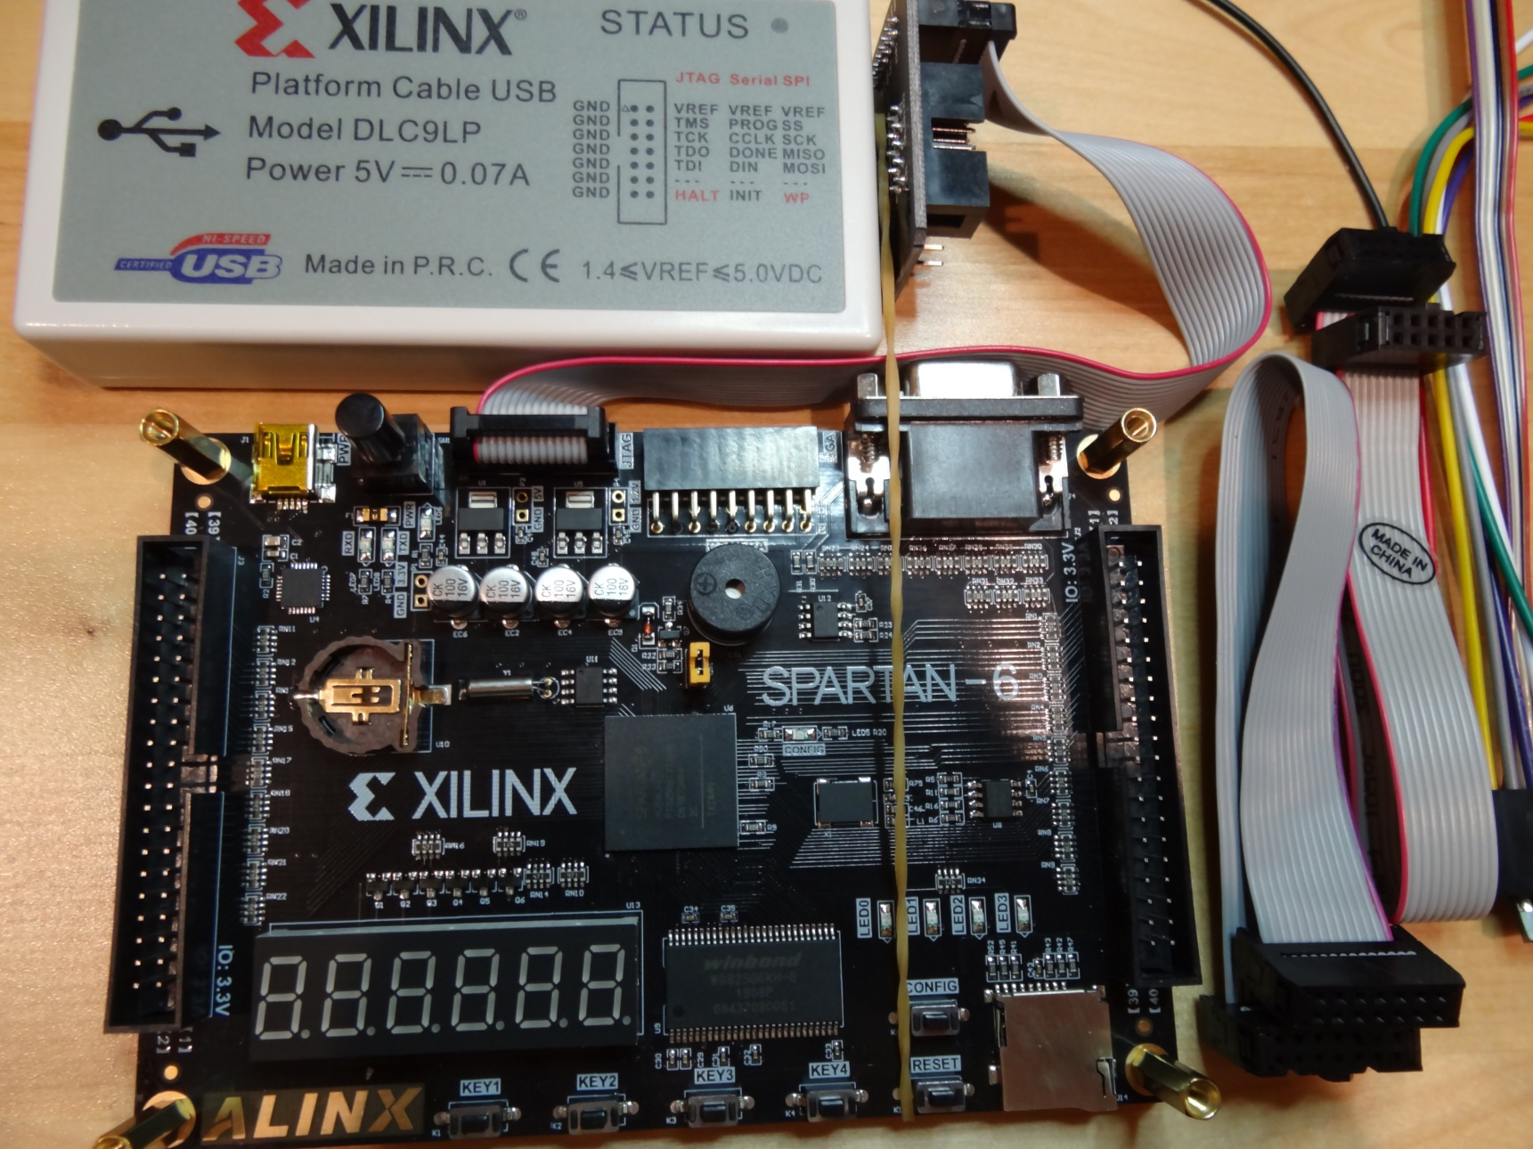
Alinx Spartan-6 board & JTAG
The Alinx Spartan-6 requires a JTAG programmer, shown attached
Notes:
Kit price quantity one: $31.20, by sharing a JTAG programmer: $20.77 plus taxes & shipping. Uses Xilinx mature ISE tools. JTAG programmer shown has full set of cables.

Slide 16
The Alinx Spartan-6 kit
Full set of buttons, LEDs & 7-segment digits
Supplement the Spartan-6 board:
JTAG programmer $11.30 for one
Price varies widely from $11 to $200+
Shorting jumpers $0.85 for ten
A substitute for slide switches
And learning the Xilinx ISE software tools
ISE not recommended for new students
Can make an exception for high school students
ISE 14.7 takes 17GB installed
Notes:
The Digital simulator can be used to generate the VHDL or Verilog (https://github.com/hneemann/Digital/). ISE does not require constraint files.

Slide 17
The Tang nano 9K kit
Supplement the Tang 9K Nano FPGA board:
Display board: $2.90
12 position DIP switch $1.06 for one
Solderless bread board $6.69 for four
Will require some user wiring
Insulated 22 gauge jumper wire
Five or more male-female jumper wires
or replacing display board pins with jumper wires
Pins on Tang FPGA board require soldering
And learning the Nano board software tools
VHDL, Verilog and constraint files supported.
Notes:
The Digital simulator can be used to generate the VHDL or Verilog (https://github.com/hneemann/Digital/). However, the constraint file needs to be edited or entered via Gowin constraint editor.

Slide 18
Display board tm1638-7-segment-display-keypad-led-module
Provides:
8 7-seg digits
8 discrete LEDs
8 push buttons
for $2.90
Notes:
Uses 4 volt driver chip, should work at 3.3 volts? Driver chip uses a SPI like interface. VHDL/Verilog example web links on sheet titled “RTL for driving display”.

Slide 19
DIP Switch
Twelve position DIP switch gives best cost/ benefit ratio.
For use on breadboard will need to fold out every 6th pin.
Notes:
Individual slide switches are relatively expensive. For best connections to breadboard use DIP switches with full size pins (shown). To reclaim folded out pins solder a fine wire up and down the fold-out side (normally all connected to ground).

Slide 20
Solderless Breadboard
Best deal in quantity three
or sixteen
The DIP switch
to straddle
ground column
and signal rows
Sufficient size to hold Tang Nano and DIP switch
Notes:
As the ground column has breaks every six spaces, will fold the DIP switch pins out for those positions; or use two five position DIP switches.
Longer versions of the breadboard available or double this module for more prototype space.

Slide 21
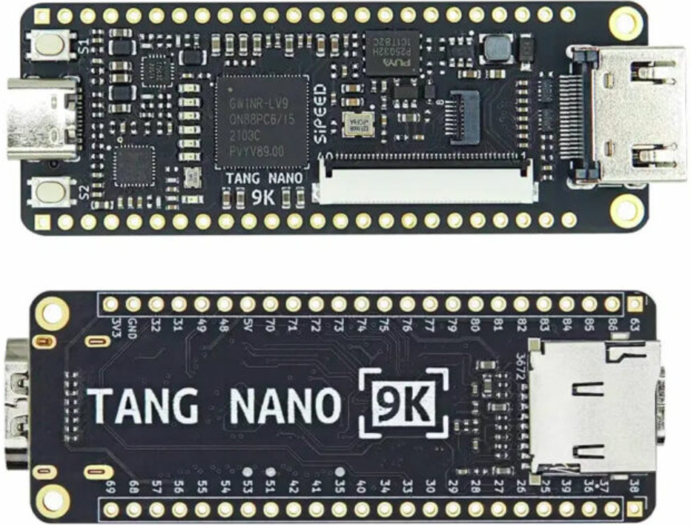
Tang 9K Nano
approximately $13 + shipping
2/21/2023
21
Notes:
Uses Gowin GW1NR-9 FPGA: 8,640 LUTs, 2 push buttons, 6 LEDs, HDMI connector, SD slot, DRAM, Two LCD connectors.
Usually has unsoldered pins. User to solder the pins needed for breadboard use. Many other low cost DIP format FPGA boards available, just not as capable for the price.

Slide 22
RTL for driving display
VHDL and Verilog for operating the TM1638 display board available at:
https://github.com/zpekic/Sys_TM1638
https://github.com/alangarf/tm1638-verilog
Notes:
Both flat cable connectors & HDMI connector accessible. Breadboard scored with knife and split allowing access to more breadboard rows. Top power buss rotated 180 degrees and shifted to align with DIP switch pins. Adhesive breadboard backing exposed and mounted on piece of wood. Rubber bands used to hold display board & dress the jumpers.

Slide 23
Tang nano 9K: What is missing
Tutorials:
https://learn.lushaylabs.com/tang-nano-series/
https://wiki.sipeed.com/hardware/en/tang/Tang-Nano-9K/Nano-9K.html
Courseware for the middle school student
Not planning to produce it
Not my area of expertise
Goal is for the middle school student to get familiar with digital circuits and binary
Preprogram so IO pins provide logic gate inputs to Tang nano board circuits (gates), gate outputs drive LEDs
Better yet, make use of Display board in a similar fashion
Notes:
By preprogramming the board, students can get “instant gratification” on using logic gates, buttons and LEDs. Using the display board comes later, again for instant gratification preprogram an example operation using the display board. Need to adapt Digital Designer for nano 9K and Spartan-6 boards.

Slide 24
Educational programs
Intel/Altera academy Quartus: RTL & Schematic
AMD/Xilinx university program ISE & Vivado RTL tools
Courseware for Real Digital Boolean board (RTL)
https://www.realdigital.org/course/digital-logic-for-the-boolean-board
https://www.tina.com/ (Schematic based, not free)
Support for the Digilent Basys 3 and the Terasic DE10-Lite FPGA boards
https://www.tina.com/blog/programming-fpga-boards-with-tina-using-schematic-design-entry/
Digital logic simulator (Schematic based)
Support for the Digilent Basys 3 and the TinyFPGA-BX boards
https://github.com/hneemann/Digital/
Hundreds of youtube videos and tutorials on the internet
Notes:
RTL: Register transfer language, usually VHDL or Verilog. Quartus and Vivado are mainstream tools with free education variants (reduced FPGA family support). Xilinx ISE not recommended for new users. ARM has courseware for their soft-core ARM on an FPGA: https://github.com/arm-university/Advanced-System-on-Chip-Design-Education-Kit

Slide 25
FPGA References
Twelve youtube videos on specific FPGA features (uses verilog RTL): https://www.youtube.com/playlist?list=PLEBQazB0HUyT1WmMONxRZn9NmQ_9CIKhb
Three Ages of FPGAs: A Retrospective…, Steve Trimberger, Proc. IEEE v103#3p318, 2015
www.cpe.virginia.edu/grads/pdfs/January%202016/VLSI.pdf
https://www.youtube.com/watch?v=4ntXSyOhlBY
Xilinx Part Family History, John Lazzaro,
www-inst.eecs.berkeley.edu/~cs294-59/fa10/resources/Xilinx-history/Xilinx-history.html
Altera History, corporate, http://www.fundinguniverse.com/company-histories/altera-corporation-history/
Low cost FPGA boards
https://www.joelw.id.au/FPGA/CheapFPGADevelopmentBoards
Open source IP https://opencores.org/projects
Github (open source) projects: search on “github vhdl verilog cpu”
Notes:
http://www.fundinguniverse.com/company-histories has histories of Xilinx and many other companies.

Slide 26
$20 kits versus full feature board
Tang nano 9K Boolean board
$20 versus $74
Some user wiring & soldering Ready to use
Buggy FPGA tools Mainstream tools
Needs case for transport Usable without wiring
DIP switches Slide switches
Alinx Spartan-6 Boolean board
$25 versus $74
Ready to use Ready to use
Dated tools Mainstream tools
Need to connect JTAG Built-in JTAG
Shorting jumpers Slide switches
Notes:
Files at https://github.com/jimbrake/FPGA_Boot_Camp have a date code suffix and are updated frequently. Currently several universities issue an FPGA board to each student for a one semester course. Am targeting middle school students (and the third world) with this kit,

Slide 27
Digital-Designer logic simulator
Web site: https://github.com/hneemann/Digital/
Authored by: Helmut.Neemann@mosbach.dhbw.de
Open source, other simulators available
Modified to support the Boolean board
Here, the user can use Digital for simulation
And examine the generated VHDL/Verilog
Usually without errors, great for the beginner!
Notes:
You will probably need to manually generate constraint files for Tang 9K Nano or use the Gowin constraint editor (recommended).

Slide 28
Interactive digital simulation
Schematic editor and simulator
Provides an intermediate step before RTL (Register Transfer Logic) and full FPGA tools.
Requires nothing beyond a PC.
Requires Java
Totally interactive
Generates VHDL or Verilog RTL files
Generates constraint file for vivado (the xilinx FPGA tool)
Notes:
The two main RTLs are verilog and VHDL. The most recent verilog is called System Verilog. ASIC people prefer verilog. DOD and Europe like VHDL. There are linting tools that can check your code including adherence to coding standards.

Slide 29
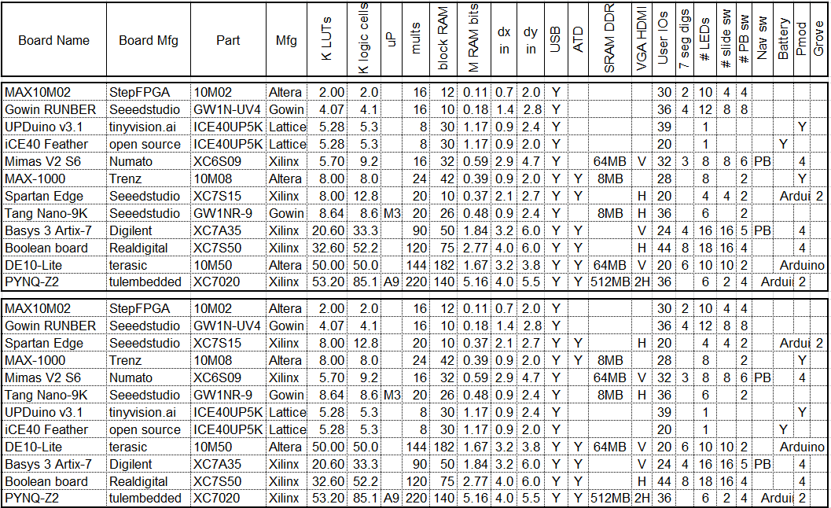
FPGA board rankings
Top version sorted by LUT count, bottom version by block RAM bit count
This listing is only a sample of the hundreds of boards available.
2/21/2023
2/21/2023
29
29

Slide 30
RTL (Register Transfer Language) VHDL and Verilog are “hardware description” languages
Separates design into combinatorial (logic) and sequential (registers).
For simple designs use a single clock
Tang Nano 9K clock is 27 MHz
Digital will generate slower clocks
Right click on clock icon & set frequency
Digital thinks the clock is 100MHz
Registers update on rising edge clock
Notes:
This FPGA Boot Camp avoids teaching VHDL or Verilog, instead you learn by seeing the VHDL or Verilog generated from your schematic. This is done to get to an easy to use FPGA “flow” (a sequence of actions needed to create and implement a design).

Slide 31
Side by side VHDL and Verilog
Digital generates both
RealDigital’s treatment:
https://www.realdigital.org/downloads/e06bddc63669cbc91ae981df18bcf3c5.pdf
Side by side System-Verilog & VHDL:
Digital Design and Computer Architecture, Harris & Harris, 2nd ed. Also ARM and RISC-V editions
Highly recommended, goes from transistors to PCs
Side by side Verilog & VHDL:
HDL Programming Fundamentals: VHDL and Verilog, Nazeih Botros 2006
Also: https://www.fpga4student.com/2017/08/verilog-vs-vhdl-explain-by-example.html
Notes:
System Verilog is a modern version of Verilog and provides the same capabilities as VHDL.

Slide 32
What FPGA tools do
Much goes on behind the scenes
Circuit is optimized (logic simplification)
unused stuff is pruned, if no outputs then all pruned
Circuit is mapped into FPGA primitives
Circuit wired up with FPGA routing resources
Bit file generated that configures the chip
Error checking especially missing semicolons
Reports on timing, resources used, error messages
A schematic viewer will show chip details
Elaborated Design show’s vivado’s version of schematic
Notes:
FPGA tools are very good at logic optimization and good at interconnecting logic units, not perfect on placement of LUTs and Block RAMs.
Tools allow optimization for speed and area with level of effort controls. Often times optimization for area also gives good speed.
Modern practice is to use a constraint file to set the desired clock speed and let the FPGA tool optimize for that setting.

Slide 33
My view of binary
Zero and ones: One names a single such signal or a group of such signals (subscripted by bit number)
A binary number is a polynomial:
A[n-1]x^{n-1} + A[n-2]x^{n-2} + … A[1]x¹ + A[0]x⁰
Where X = 2, and A[n] are 0 or 1 bits from the number. If A[n-1] is 0/-1 then it is 2’s complement and negative if A[n-1] is -1.
It is typical for the bit numbers to run from N-1 to 0 where N is the number of bits.
Adding or subtracting 2’s complement wraps around in a circle where the most positive and most negative numbers are adjacent (any carry or borrow beyond x^{n-1} is discarded).
Windows calculator has binary features: https://www.youtube.com/watch?v=PK5WQqN3_44
Max Maxfield’s explanation of binary:
https://www.eejournal.com/article/mysteries-of-the-ancients-binary-coded-decimal-bcd/
Notes:
The youtube video covers all the calculator features including radix (binary, hex, decimal) and the binary operations (AND, OR, XOR, shifts and rotate). Maxfield explains more than just BCD and binary.

Slide 34
FPGA Video Tutorials
There are a wealth of youtube videos on these subjects including whole sets of videos
https://nandland.com/fpga-101/ and
https://www.youtube.com/watch?v=CfmlsDW3Z4c
https://www.youtube.com/watch?v=OUNrGLgx9h4
Recommended
My favorite FPGA video series:
https://www.youtube.com/@SimplyEmbedded/videos
https://www.youtube.com/@SimplyEmbedded/playlists

Slide 35
Advanced FPGA boards and education
A continuum of boards from basic to very advanced
Large FPGAs: millions of LUTs, GHz serial IO
Corresponding tutorials and videos:
Advanced applications: vision, neural nets, high speed A2D and D2A, robotics, etc.
Research on making FPGAs easier to use:
HLS (High Level Synthesis) generating VHDL/Verilog from C/C++
Providing means to handle the time/space trade-offs

Slide 36
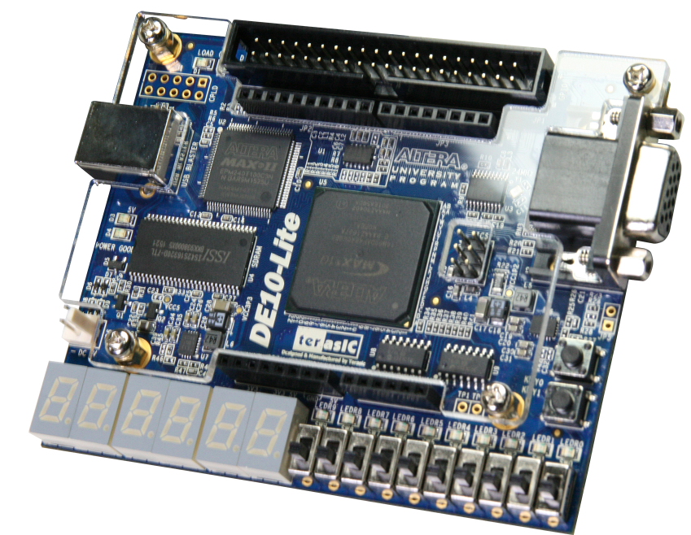
Intel/Altera academic program
https://www.intel.com/content/www/us/en/developer/topic-technology/fpga-academic/overview.html
https://www.intel.com/content/www/us/en/developer/topic-technology/fpga-academic/materials.html
https://fpgacademy.org/tools.html
https://fpgacademy.org/courses.html
DE10-Lite academic price $82
Notes:
Only two push buttons. Least expensive Altera board with “full” user IO. VGA video output, DRAM chip & microSD card slot. Arduino and Raspberry Pi connectors.

Slide 37
RealDigital boards

Slide 38
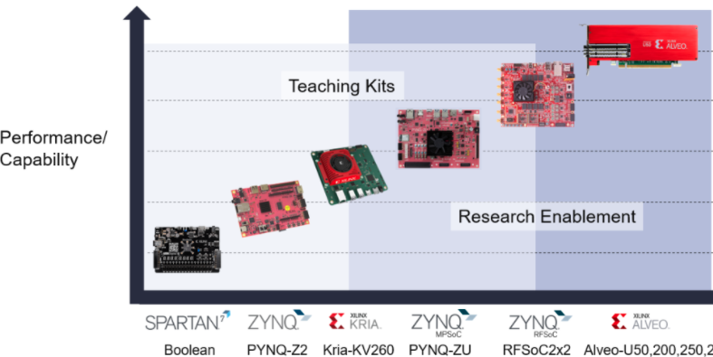
Xilinx university program
https://www.xilinx.com/support/university.html
https://www.xilinx.com/support/university/boards-portfolio/xup-boards/RealDigitalBoolenBoard.html
$74 $123 $200
$549
$2149
$7695
Notes:
Boolean Board “endorsement” by Xilinx. Kria-KV260 has state-of-the-art FPGA.

